Slide 1

Note
Bandwidth utilization is the wise use of available bandwidth to achieve specific goals.
Efficiency can be achieved by multiplexing; privacy and anti-jamming can be achieved by spreading.

Slide 2
6-1 MULTIPLEXING
Whenever the bandwidth of a medium linking two devices is greater than the bandwidth needs of the devices, the link can be shared. Multiplexing is the set of techniques that allows the simultaneous transmission of multiple signals across a single data link. As data and telecommunications use increases, so does traffic.
Topics discussed in this section:
Frequency-Division Multiplexing Wavelength-Division Multiplexing Synchronous Time-Division Multiplexing
Statistical Time-Division Multiplexing

Slide 3
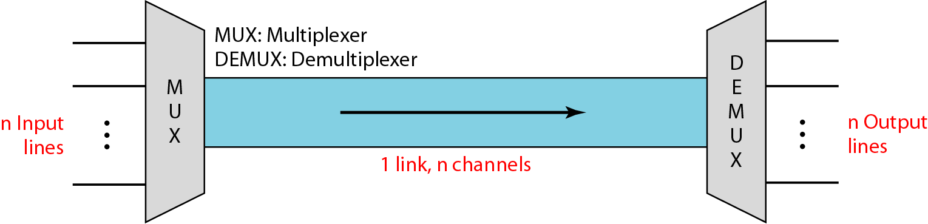
Figure 6.1 Dividing a link into channels

Slide 4
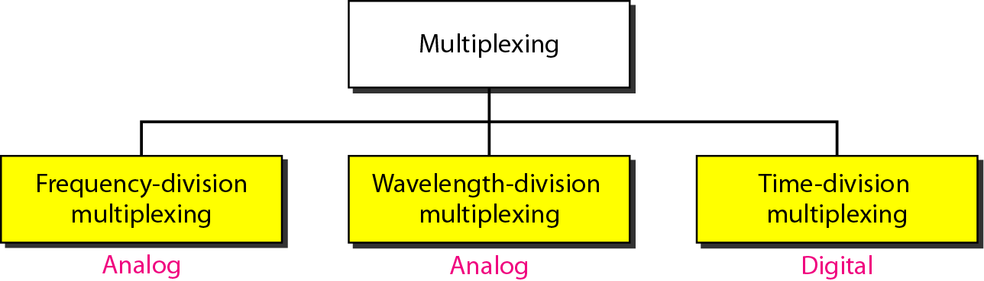
Figure 6.2 Categories of multiplexing

Slide 5
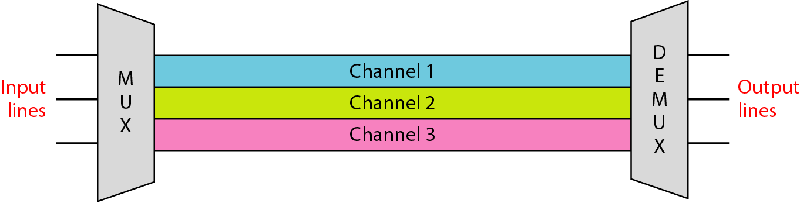
Figure 6.3 Frequency-division multiplexing

Slide 6
Note
FDM is an analog multiplexing technique that combines analog signals.
These modulated signals are then combined into a single composite signal that can be transported by the link.
Carrier frequencies are separated by sufficient bandwidth to accommodate the modulated signal.
These bandwidth ranges are the channels through which the various signals travel.
Channels can be separated by strips of unused bandwidth-guard bands-to prevent signals from overlapping.
carrier frequencies must not interfere with the original data frequencies.

Slide 7
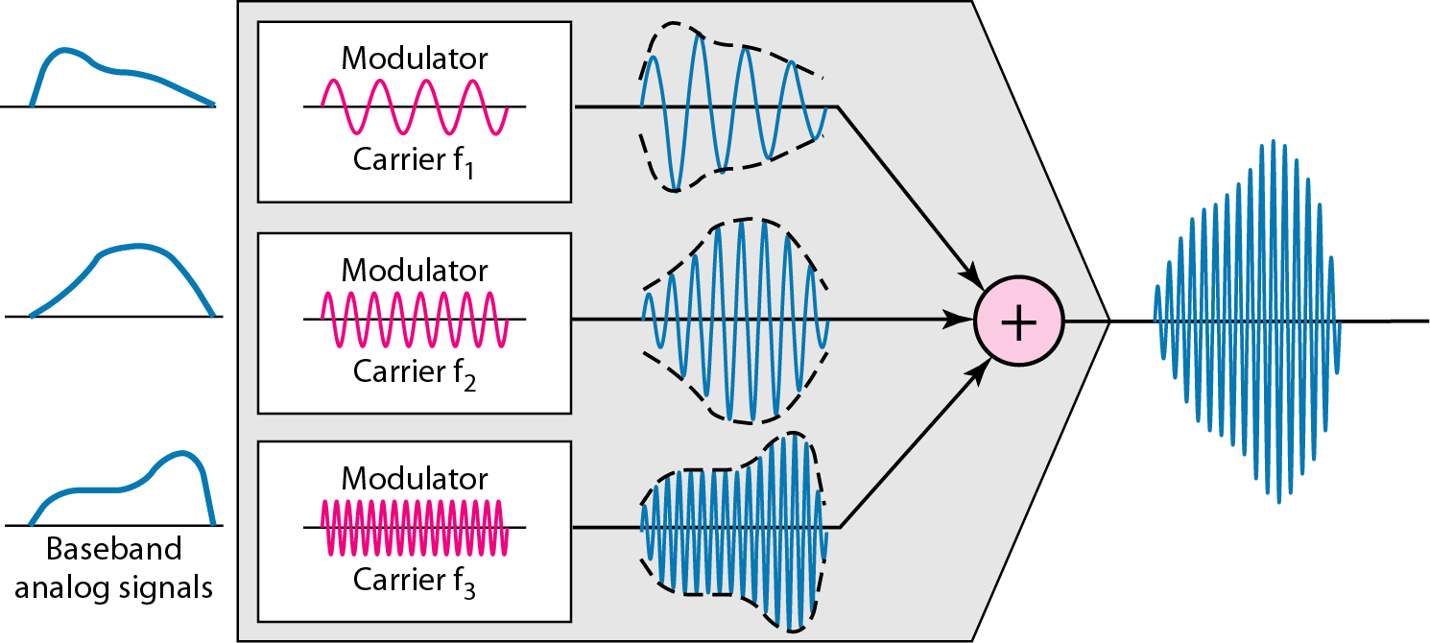
Figure 6.4 FDM process

Slide 8
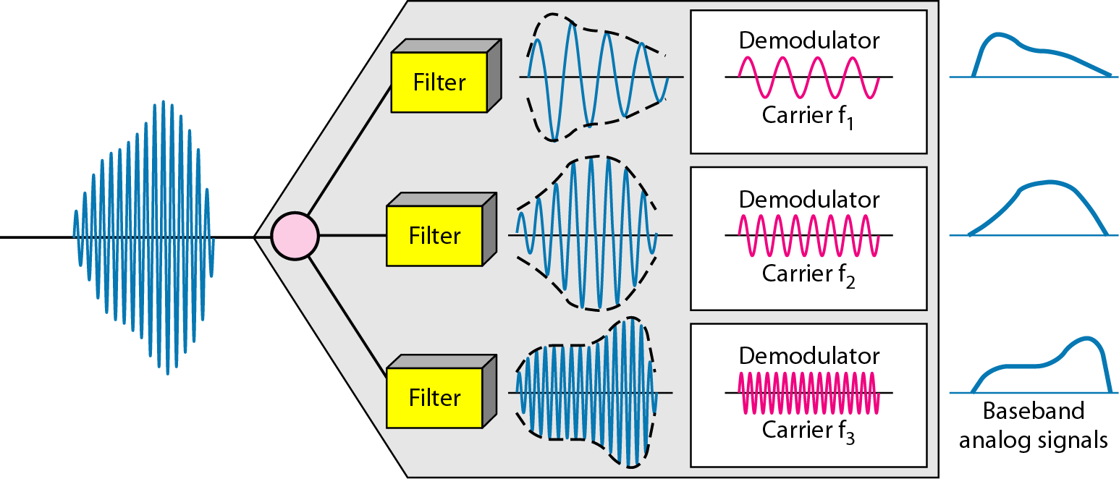
Figure 6.5 FDM demultiplexing example

Slide 9
Example
Assume that a voice channel occupies a bandwidth of 4 kHz. We need to combine three voice channels into a link with a bandwidth of 12 kHz, from 20 to 32 kHz. Show the configuration, using the frequency domain. Assume there are no guard bands.
Solution
We shift (modulate) each of the three voice channels to a different bandwidth, as shown in Figure 6.6. We use the 20- to 24-kHz bandwidth for the first channel, the 24- to 28-kHz bandwidth for the second channel, and the 28- to 32-kHz bandwidth for the third one. Then we combine them as shown in Figure 6.6.

Slide 10
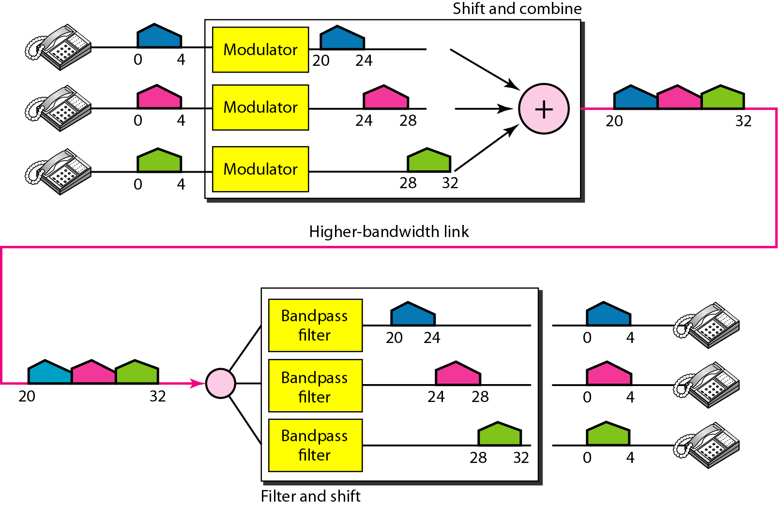
Figure 6.6 Example 6.1

Slide 11
Example 6.2
Five channels, each with a 100-kHz bandwidth, are to be multiplexed together. What is the minimum bandwidth of the link if there is a need for a guard band of 10 kHz between the channels to prevent interference?
Solution
For five channels, we need at least four guard bands. This means that the required bandwidth is at least
5 × 100 + 4 × 10 = 540 kHz,
as shown in Figure 6.7.

Slide 12
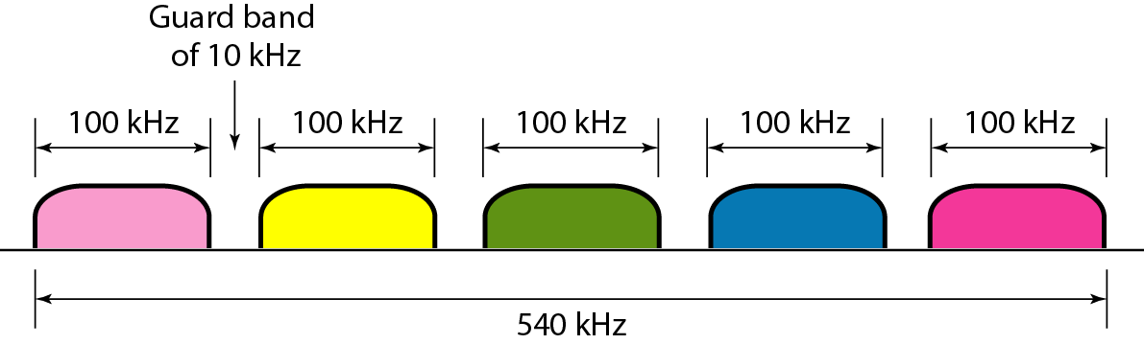
Figure 6.7 Example 6.2

Slide 13
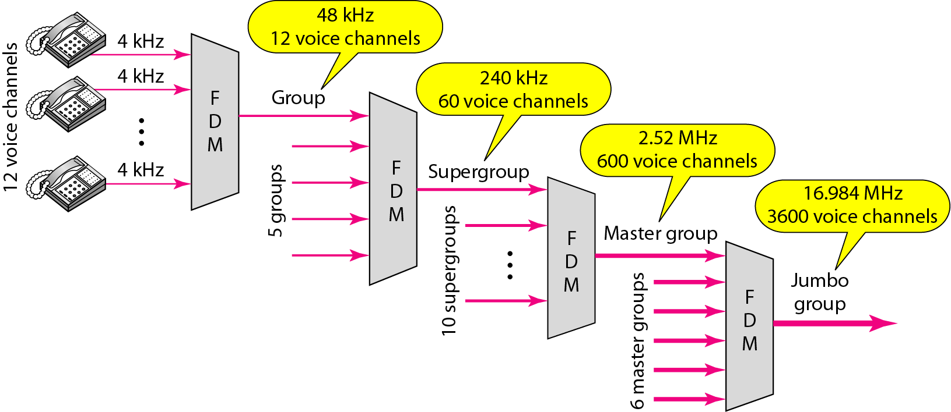
Figure 6.9 Analog hierarchy

Slide 14
Wavelength-division multiplexing
Wavelength-division multiplexing (WDM) is designed to use the high-data-rate capability of fiber-optic cable.
The optical fiber data rate is higher than the data rate of metallic transmission cable. Using a fiber-optic cable for one single line wastes the available bandwidth.
Multiplexing allows us to combine several lines into one.
optical signals transmitted through fiber-optic channels.
combine multiple light sources into one single light at the multiplexer and do the reverse at the demultiplexer.
The combining and splitting of light sources are easily handled by a prism.

Slide 15
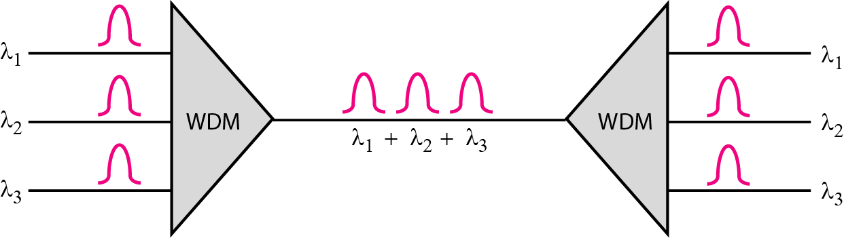
Figure 6.10 Wavelength-division multiplexing

Slide 16
Note
WDM is an analog multiplexing technique to combine optical signals.

Slide 17
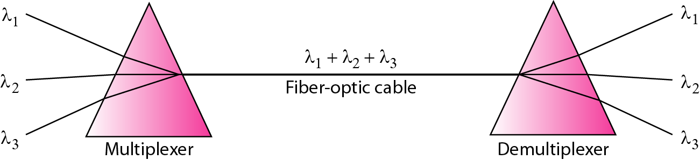
Figure 6.11 Prisms in wavelength-division multiplexing and demultiplexing

Slide 18
TDM
Time-division multiplexing (TDM) is a digital process that allows several connections to share the high bandwidth of a line.
Instead of sharing a portion of the bandwidth as in FDM, time is shared.
Each connection occupies a portion of time in the link.

Slide 19
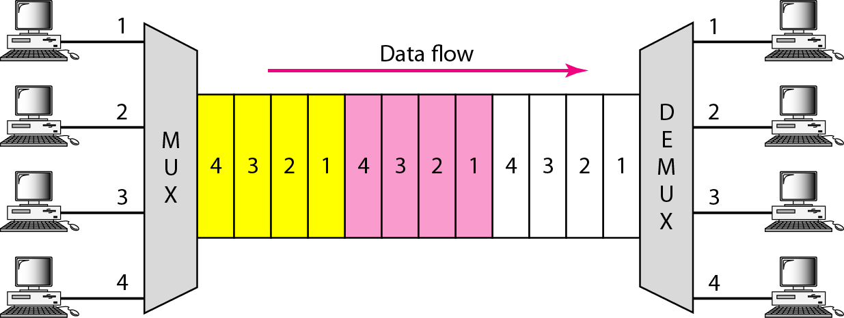
Figure 6.12 TDM

Slide 20
Note
TDM is a digital multiplexing technique for combining several low-rate channels into one high-rate one.

Slide 21
Synchronous time-division multiplexing
In synchronous TDM, each input connection has an allotment in the output even if it is not sending data.
Time Slots and Frames:
In synchronous TDM, the data flow of each input connection is divided into units, where ach input occupies one input time slot.
A unit can be 1 bit, one character, or one block of data.
Each input unit becomes one output unit and occupies one output time slot. However, the duration of an output time slot is n times shorter than the duration of an input time slot.

Slide 22
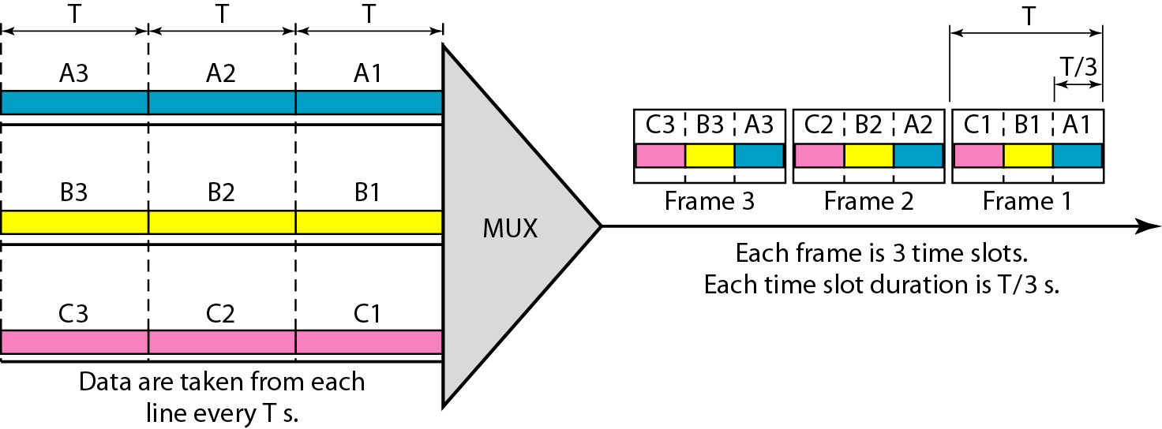
Figure 6.13 Synchronous time-division multiplexing

Slide 23
Note
In synchronous TDM, the data rate of the link is n times faster, and the unit duration is n times shorter.

Slide 24
Example 6.5
In Figure 6.13, the data rate for each input connection is 1 kbps. If 1 bit at a time is multiplexed (a unit is 1 bit), what is the duration of (a) each input slot, (b) each output slot, and (c) each frame?
Solution
We can answer the questions as follows:
a. The data rate of each input connection is 1 kbps. This means that the bit duration is 1/1000 s or 1 ms. The duration of the input time slot is 1 ms (same as bit duration).

Slide 25
Example 6.5 (continued)
b. The duration of each output time slot is one-third of the input time slot. This means that the duration of the output time slot is 1/3 ms.
c. Each frame carries three output time slots. So the duration of a frame is 3 × 1/3 ms, or 1 ms. The duration of a frame is the same as the duration of an input unit.

Slide 26
Example 6.6
Figure 6.14 shows synchronous TDM with a data stream for each input and one data stream for the output. The unit of data is 1 bit. Find (a) the input bit duration, (b) the output bit duration, (c) the output bit rate, and (d) the output frame rate.
Solution
We can answer the questions as follows:
a. The input bit duration is the inverse of the bit rate: 1/1 Mbps = 1 μs.
b. The output bit duration is one-fourth of the input bit duration, or ¼ μs.

Slide 27
Example 6.6 (continued)
c. The output bit rate is the inverse of the output bit duration or 1/(4μs) or 4 Mbps. This can also be deduced from the fact that the output rate is 4 times as fast as any input rate; so the output rate = 4 × 1 Mbps = 4 Mbps.
d. The frame rate is always the same as any input rate. So the frame rate is 1,000,000 frames per second. Because we are sending 4 bits in each frame, we can verify the result of the previous question by multiplying the frame rate by the number of bits per frame.

Slide 28
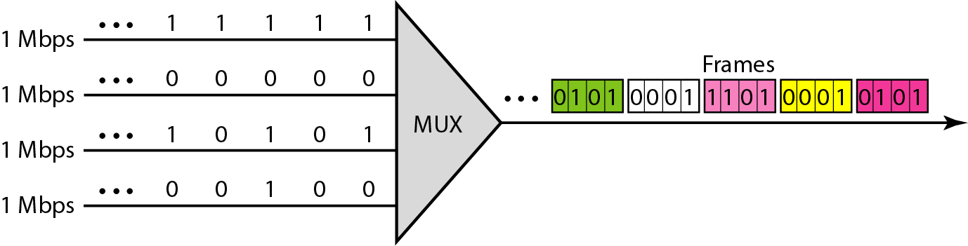
Figure 6.14 Example 6.6

Slide 29
Example 6.7
Four 1-kbps connections are multiplexed together. A unit is 1 bit. Find (a) the duration of 1 bit before multiplexing, (b) the transmission rate of the link, (c) the duration of a time slot, and (d) the duration of a frame.
Solution
We can answer the questions as follows:
a. The duration of 1 bit before multiplexing is 1 / 1 kbps, or 0.001 s (1 ms).
b. The rate of the link is 4 times the rate of a connection, or 4 kbps.

Slide 30
Example 6.7 (continued)
c. The duration of each time slot is one-fourth of the duration of each bit before multiplexing, or 1/4 ms or 250 μs. Note that we can also calculate this from the data rate of the link, 4 kbps. The bit duration is the inverse of the data rate, or 1/4 kbps or 250 μs.
d. The duration of a frame is always the same as the duration of a unit before multiplexing, or 1 ms. We can also calculate this in another way. Each frame in this case has four time slots. So the duration of a frame is 4 times 250 μs, or 1 ms.

Slide 31
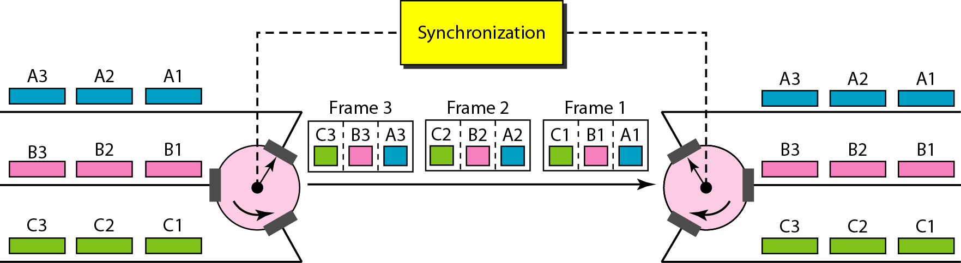
Figure 6.15 Interleaving

Slide 32
Example 6.8
Four channels are multiplexed using TDM. If each channel sends 100 bytes /s and we multiplex 1 byte per channel, show the frame traveling on the link, the size of the frame, the duration of a frame, the frame rate, and the bit rate for the link.
Solution
The multiplexer is shown in Figure 6.16. Each frame carries 1 byte from each channel; the size of each frame, therefore, is 4 bytes, or 32 bits. Because each channel is sending 100 bytes/s and a frame carries 1 byte from each channel, the frame rate must be 100 frames per second. The bit rate is 100 × 32, or 3200 bps.

Slide 33
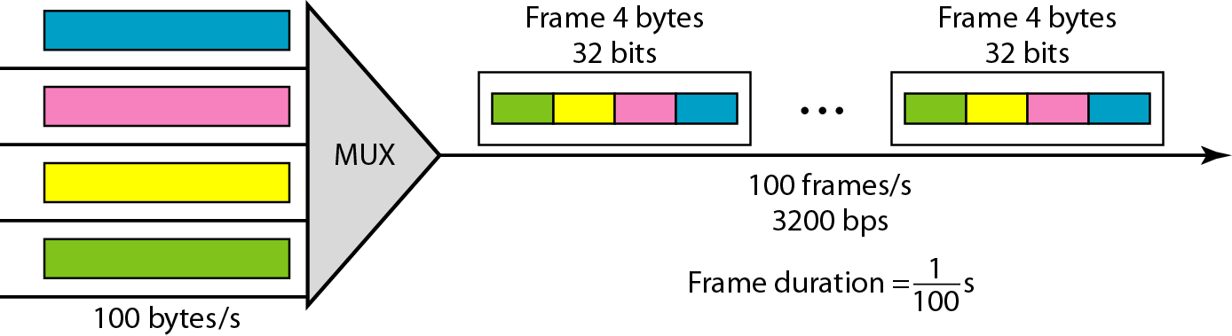
Figure 6.16 Example 6.8

Slide 34
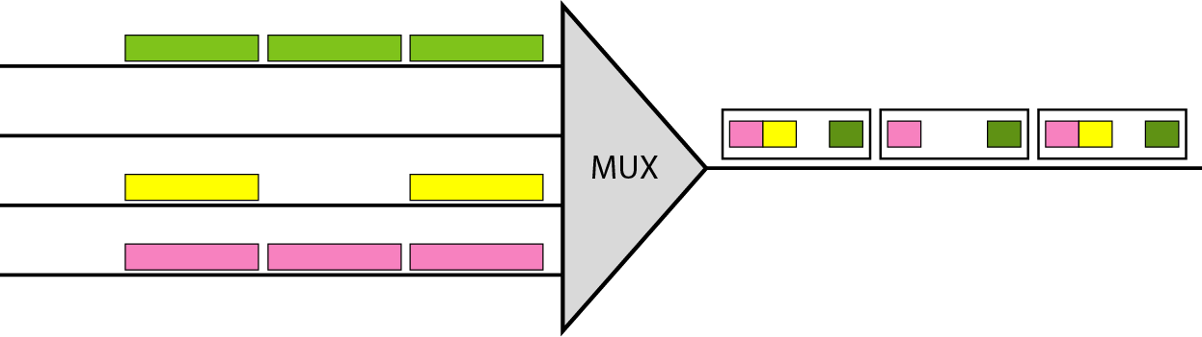
Figure 6.18 Empty slots

Slide 35
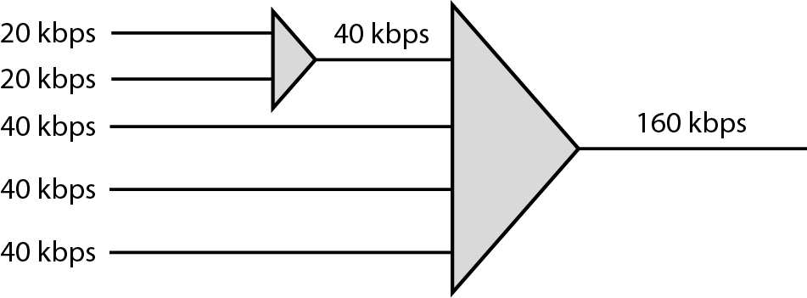
Figure 6.19 Multilevel multiplexing

Slide 36
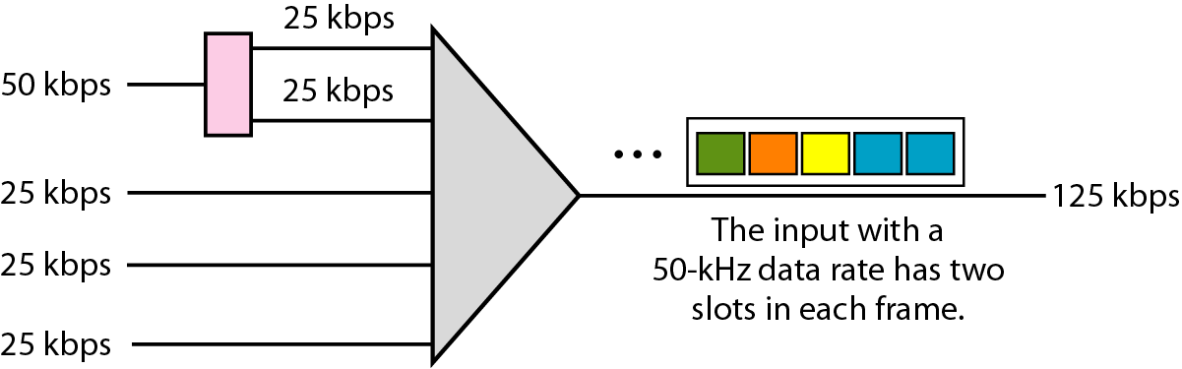
Figure 6.20 Multiple-slot multiplexing

Slide 37
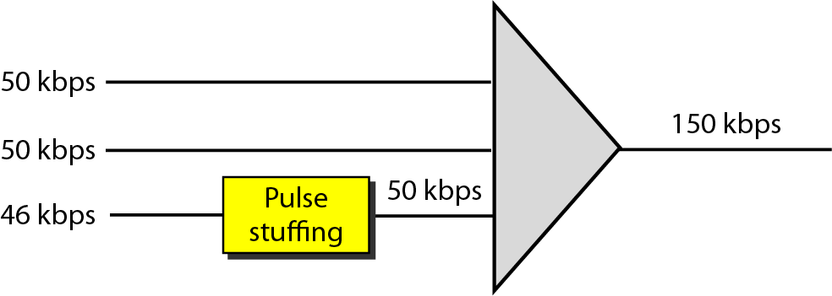
Figure 6.21 Pulse stuffing

Slide 38
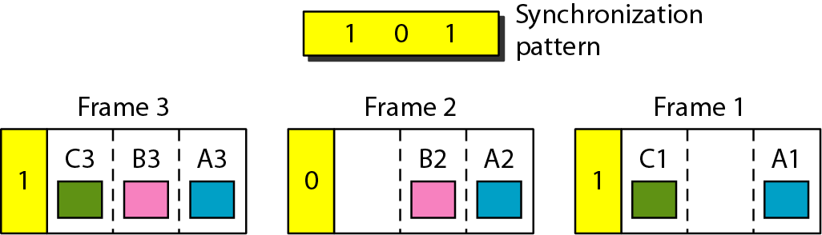
Figure 6.22 Framing bits

Slide 39
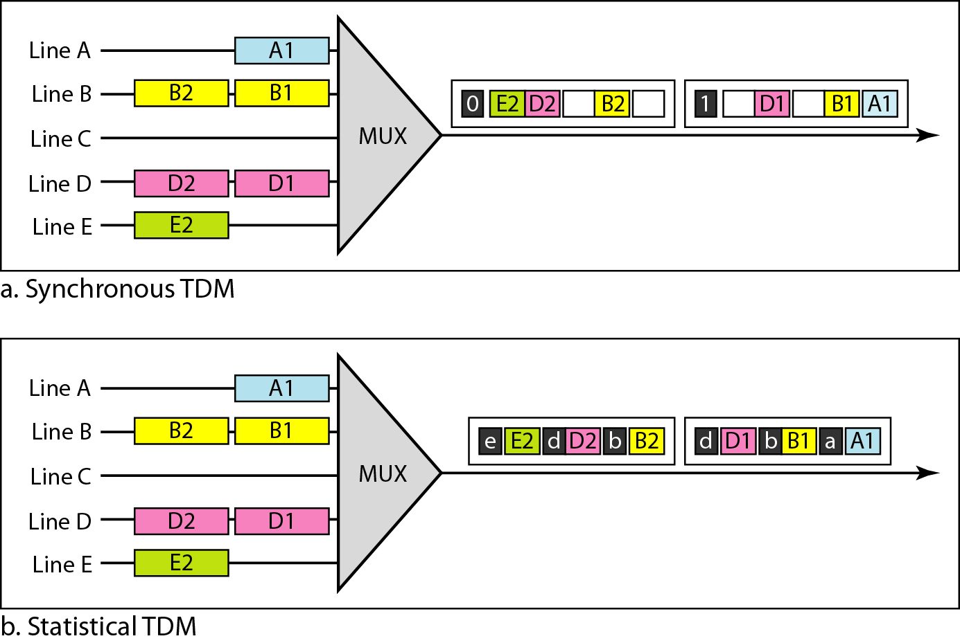
Figure 6.26 TDM slot comparison

Slide 40
6-1 SPREAD SPECTRUM
In spread spectrum (SS), we combine signals from different sources to fit into a larger bandwidth, but our goals are to prevent eavesdropping and jamming. To achieve these goals, spread spectrum techniques add redundancy.
Topics discussed in this section:
Frequency Hopping Spread Spectrum (FHSS) Direct Sequence Spread Spectrum Synchronous (DSSS)

Slide 41
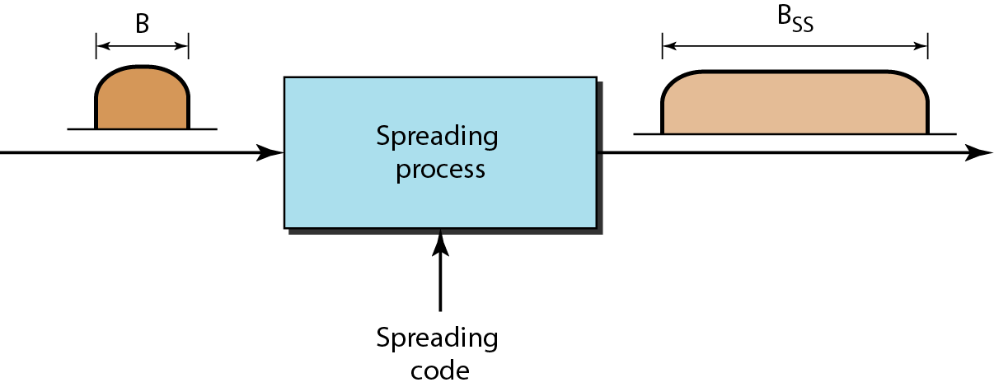
Figure 6.27 Spread spectrum

Slide 42
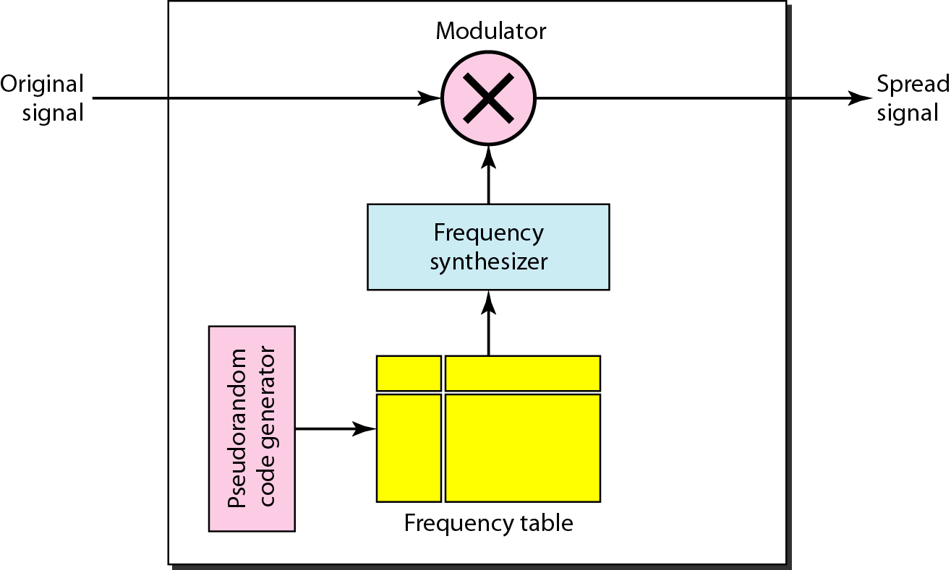
Figure 6.28 Frequency hopping spread spectrum (FHSS)

Slide 43
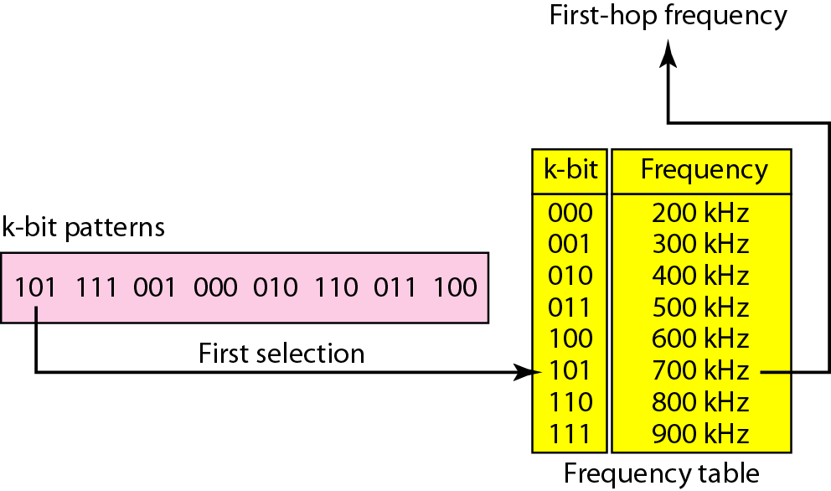
Figure 6.29 Frequency selection in FHSS

Slide 44
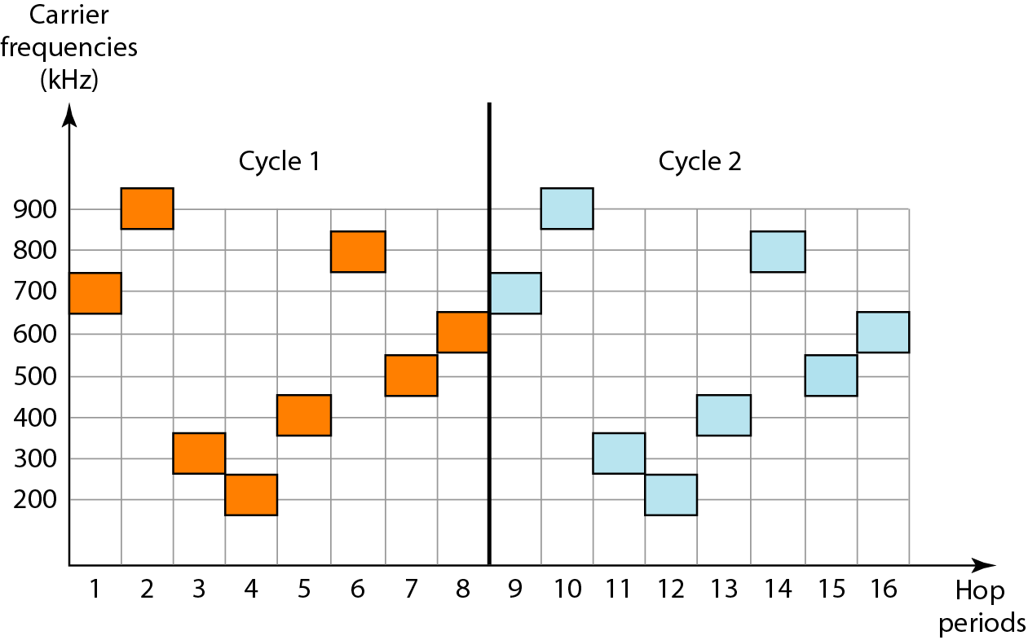
Figure 6.30 FHSS cycles

Slide 45
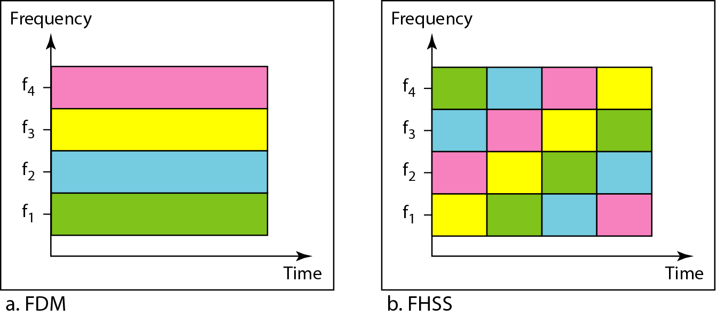
Figure 6.31 Bandwidth sharing

Slide 46
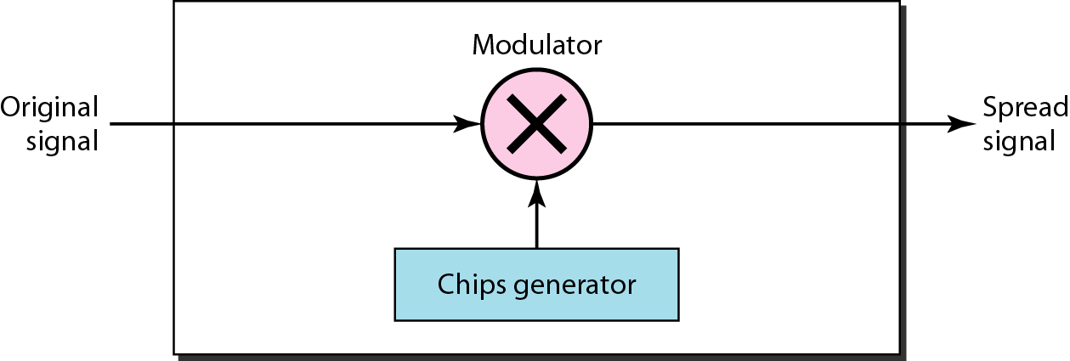
Figure 6.32 DSSS

Slide 47
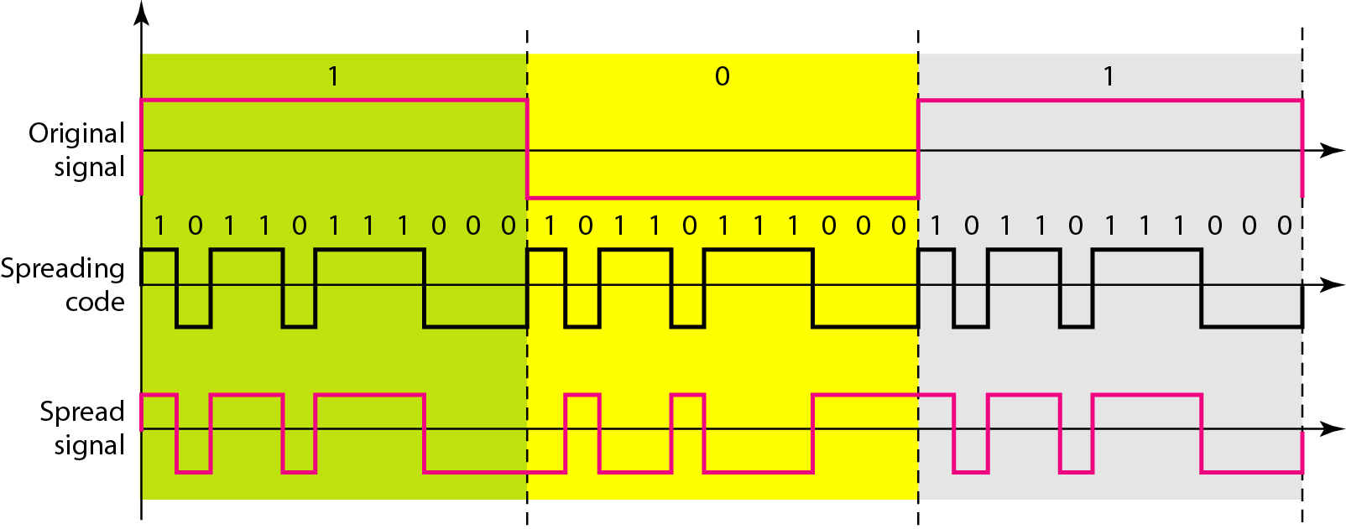
Figure 6.33 DSSS example

Slide 48

References
Chapter 6
Bandwidth Utilization:
Multiplexing and Spreading

